Slide 1

DATA ANALYTICS IN HEALTHCARE
-RAHUL JADHAV

Slide 2




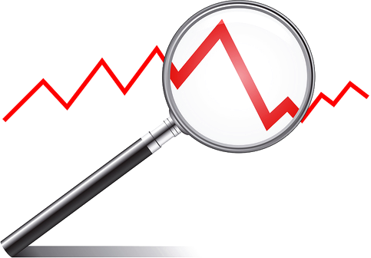
What is Data Analytics ?
Data analytics is the process of interpreting
QUANTITATIVE DATA
QUALITATIVE INSIGHTS
TO REVEAL
TO
ANSWER QUESTIONS
, AND TO
IDENTIFY TRENDS
Source https://online.hbs.edu/blog/post/data-analytics-in-healthcare

Slide 3






INDUSTRIES
ENERGY
FINANCIAL
HEALTHCARE
INDUSTRIAL
REAL ESTATE

Slide 4
INDUSTRIES
HEALTH CARE EQUIPMENT & SUPPLIES
HEALTH CARE PROVIDERS & SERVICES
HEALTH CARE TECHNOLOGY
BIOTECHNOLOGY
PHARMACEUTICALS
LIFE SCIENCES TOOLS & SERVICES
Source https://www.msci.com/our-solutions/indexes/gics

Slide 5
TYPES OF DATA ANALYSIS
Descriptive analysis
Diagnostic analysis
Predictive analysis
Prescriptive analysis

Slide 6
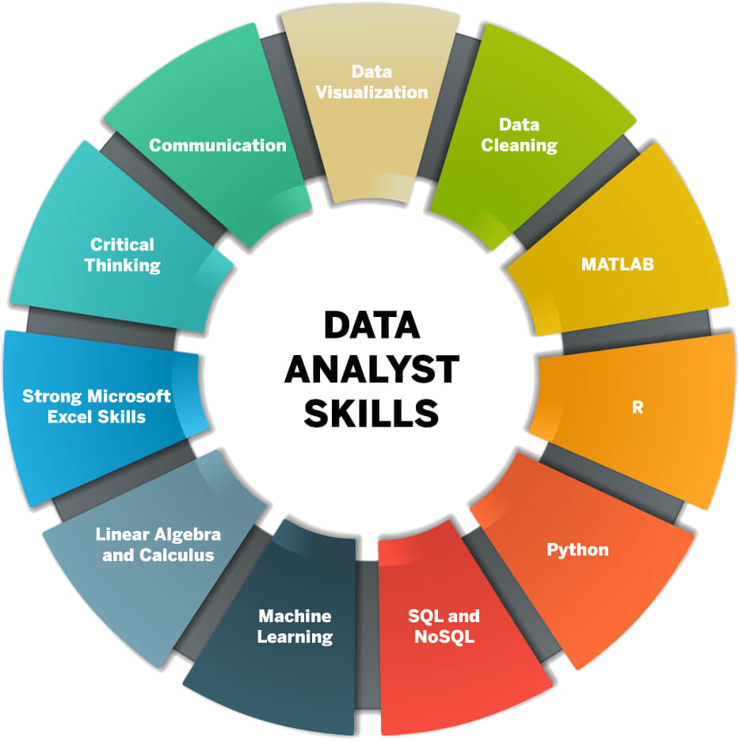
TECHNICAL SKILLSET

Slide 7
RESPONSIBILITIES OF ANALYST
Compile and organize health care data
Analyze data
Use health care data
Understand data storage and data sharing methods
Investigate data
Understand health care business operations
Utilize different data sources for analysis
Convert data
Develop reports and presentations
Communicate analytic insights to management
Source https://onlinedegrees.sandiego.edu/health-data-analyst/

Slide 8
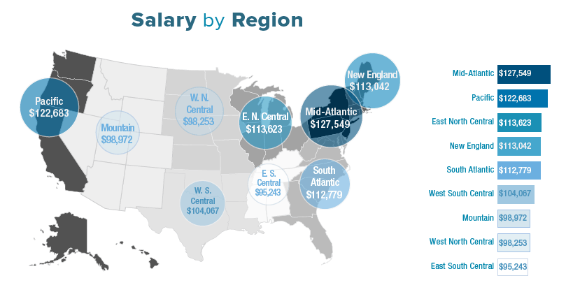
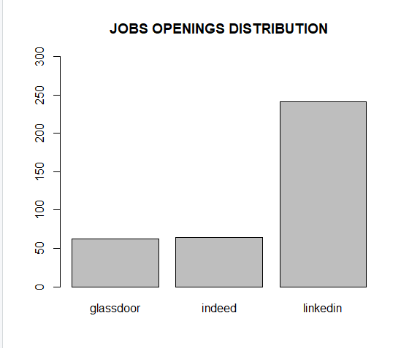
SALARIES BY REGION
Source https://healthitanalytics.com/news/him-healthcare-analytics-staff-bringing-in-big-salaries
JOB POSTING SITES

Slide 9






TOP COMAPANIES
IBM
Cerner
Health Catalyst
HealthEC
Amitech
Acmeware
https://www.verifiedmarketresearch.com/blog/top-healthcare-data-analytics-companies/

Slide 10
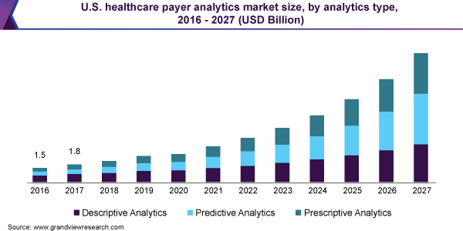
FUTURE GROWTH
Source https://www.grandviewresearch.com/industry-analysis/us-healthcare-payer-analytics-market

Slide 11
CONCLUSION
All the information given in the above slides are important information about the Healthcare Data Analysis.
As per salaries by region, MID ATLANTIC region has the highest salary.
As per Bar plot, The maximum job posting is done on LinkedIn (note the data was collected manually by searching job for healthcare domain in compared sites and csv was generated accordingly)
IBM is the top company in the field as per the www.verifiedmarketresearch.com
As per graph by Grandview research, the market size of analytics in healthcare will be approx. USD 13.3 billion

Slide 12
Bibliography
3 applications of data analytics in healthcare - Harvard Business School Online. Business Insights - Blog. (2021, February 18). Retrieved October 17, 2021, from https://online.hbs.edu/blog/post/data-analytics-in-healthcare.
GICS - Global Industry Classification Standard. MSCI. (n.d.). Retrieved October 17, 2021, from https://www.msci.com/our-solutions/indexes/gics.
PhD, J. M., Director of Health Care and Nursing Informatics and Health Systems Leadership, », R. F. B., & Dr. Mack earned his R.N. Diploma in 1983 from Los Angeles County Medical Center. (2021, March 15). What is a health care data analyst? University of San Diego. Retrieved October 17, 2021, from https://onlinedegrees.sandiego.edu/health-data-analyst/.
LinkedIn (2021) jobs collected from: https://www.linkedin.com/jobs/search/?geoId=102380872&keywords=healthcare%20data%20analyst&location=Boston%2C%20Massachusetts%2C%20United%20States
Glassdoor(2021) jobs collected from: https://www.glassdoor.com/Job/boston-ma-us-healthcare-data-analyst-jobs-SRCH_IL.0,12_IC1154532_KO13,36.htm?clickSource=searchBox
Indeed(2021) jobs collected from: https://www.indeed.com/jobs?q=healthcare%20data%20analyst&l=boston&vjk=39302495db18605b

Slide 13

THANKYOU

